Slide 1
The influence of the selective serotonin re-uptake inhibitors on spermatogenesis in fertile men with depression M. Korshunov¹, I. Vinogradov¹, M. Gabliya¹, Y. Shtyrya³, E. Korshunova² ¹Department of Clinical Andrology, The Federal State Budget Institution Peoples’ Friendship University of Russia, Moscow, Russia ²Research Center of psychoneurology, urology department, Moscow, Russia, ³Russian-German center for reproduction and clinical embryology “Pokolenie NEXT”, Moscow, Russia
Nr. 183

Slide 2
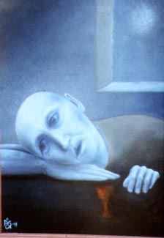
Antidepressants
Infertility Depression

Slide 3
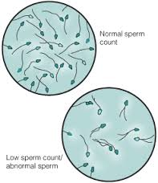
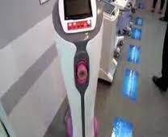
Morbid vicious circle
Infertility
Depression

Slide 4
Selective serotonin re-uptake inhibitors
Paroxetine
Sertraline
Fluoxetine
Citaloprame
Fluvaxamine
Dapoxetine
Neuron
SSRIs
Re-uptake
Serotonin
Receptor

Slide 5
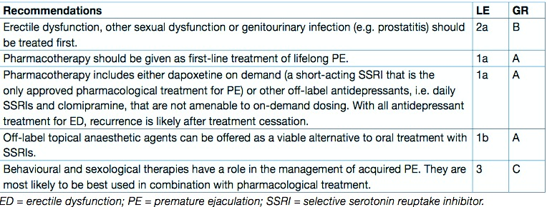
EAU Guidelines on treatment of premature ejaculation (2014)
EAU Guidelines on treatment of premature ejaculation (2014)

Slide 6
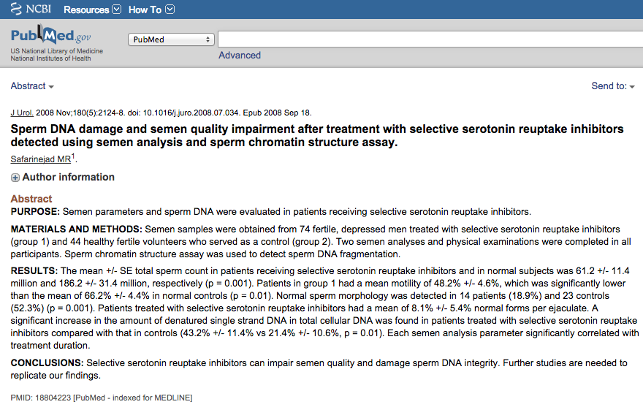

Slide 7
Aim of study:
To evaluate the effect of SSRIs on spermatogenesis in the treatment of depression

Slide 8
Material & Methods:
19 married fertile (have children) men with depression of mild severity (the mean age 35,2±4,5 SD years)
None of them has any urological disorders
All the patients were examined by the psychiatrist
The patients were treated by fluoxetine 20 mg per day during 6 weeks
Semen analysis was performed according to the WHO 5 guidelines before starting medication, after the therapy and 3 months of drug discontinuation
Level of DNA fragmentation was determined by «Halosperm» method

Slide 9
Results:
All the men had normal parameters of sperm before the treatment
After 6 weeks of the treatment the mean volume of semen decreased from 3,1±0,7 to 2,9±0,5 ml SD, the mean sperm concentration ↓ from 39,4±18,5х10⁶ to 34,3±16,8х10⁶ SD, the sperm motility (a+b) ↓ from 41,7±7,6 to 35,5±7,8% SD, the mean percent of normal morphology felt down from 16,7±2,8 to 10,7±2.2 SD. The mean percentage DNA fragmentation of spermatozoa increased from 16,2±4,9 to 22,2±4,3 SD
After 3 months of drug discontinuation the volume of semen increased to 3,2±1,8 ml, sperm concentration ↑to 36,1±17,5х10⁶, the mean motility ↑to 39,5±8,6, % of normal morphology↑ to 15,1±2,4% SD. Sperm DNA fragmentation index decreased to 13,8±3,1 SD
After 3 weeks of the treatment, two patients (10.5%) complained on delayed ejaculation that required a dose reduction to 10 mg per day
The reduction of the symptoms by depression scale (Beck) in all cases was fixed

Slide 10
Conclusions:
Using SSRIs may have a negative effect on spermatogenesis and male fertility within the therapy
The most changes of sperm quality (morphology and DNA structure) were registered
Three months of drug discontinuation the semen parameters revert to the normal levels
The level of DNA fragmentation decreased 3 months after the end of therapy. It had the values less then before the treatment that correlated with the reduction of depression’s symptoms
We need to get more information about negative and positive effects of using SSRIs in infertile men with depression

Slide 11
Thank you for your attention!
Russian-German center for reproduction and clinical embryology “Pokolenie NEXT”
For further information please contact : +7(905)7496457
Dr.maximkorshunov@gmail.com
100001989808491@facebook.com

