Slide 1
Astellas Urology INSIGHT Webinar
Management of OAB and LUTS: Updates on the EAU guidelines and the recent evidence
Friday, 17th March 2023

Slide 2
Speaker introduction
Professor Christian Gratzke
Professor and Chair, Department of Urology, Albert-Ludwigs-University, Freiburg, Germany
Prof. Gratzke is a leading urologist with extensive experience in prostate cancer and benign prostate enlargement. His clinical interests also include LUTS and erectile dysfunction. Prof. Gratzke is a fellow of the European Board of Urology, a member of the European Association of Urology (EAU) as well as a member of the German working group on male LUTS. He has published more than 380 articles in peer-reviewed journals, authored 15 book chapters and is the recipient of several awards including the EAU Crystal Matula Award (2017).

Slide 3
Product Label Disclaimer
The content of this presentation is aligned with the authorised use of mirabegron in your country.
These presentations include products/indications which may not be approved in your country. Physicians should take into account the patient’s individual circumstances and consult the approved product information before prescribing.
Astellas’ products availability, starting dose and indications may vary from country to country. These presentations are prepared solely for education of the healthcare professionals and does not necessarily reflect the opinions or recommendations of the sponsor.
Astellas prohibits the promotion of unapproved drug usage and complies with all applicable laws, regulations, and company policies.

Slide 4
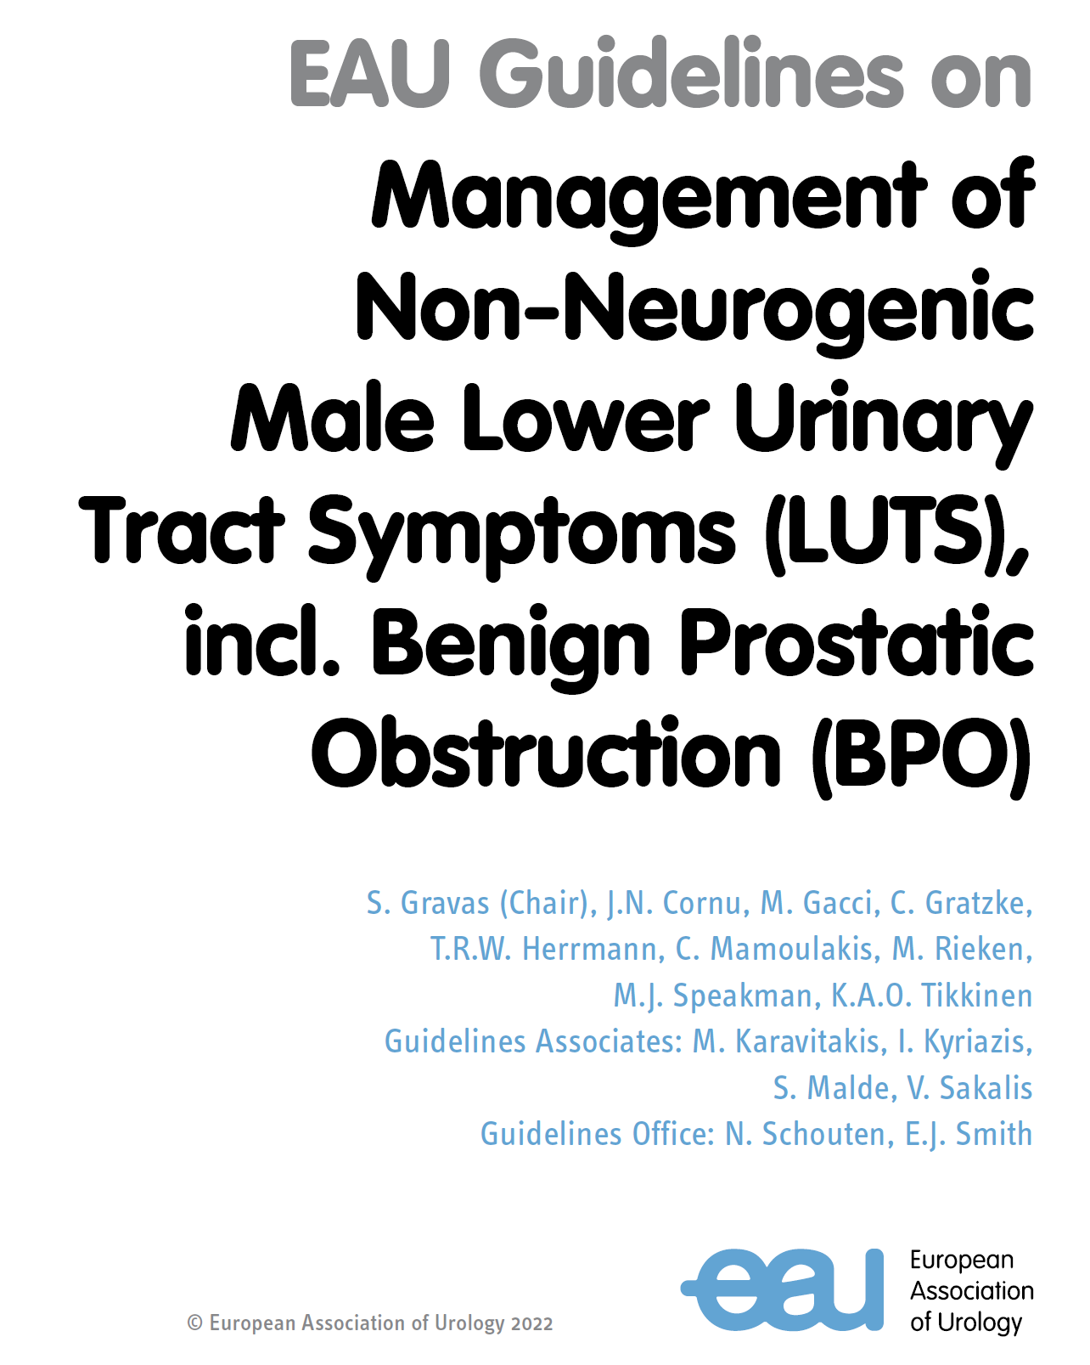
Management of OAB and LUTS: A review of the 2022 updates in the EAU guidelines
Professor Christian Gratzke
Professor and Chair, Department of Urology, Albert-Ludwigs-University, Freiburg, Germany
MAT-ZA-BET-2023-00016

Slide 5
Male LUTS: Major Updates 2022
Addition of new references (covering a time frame between 01-May-2019 and 01-May-2021)
Addition of 5.2.7.3 α1-blockers + Beta-3 agonist
Addition of 5.6 Management of male urinary incontinence
EAU Guidelines on management of non-neurogenic male lower urinary tract symptoms (LUTS), incl. benign prostatic obstruction (BPO). European Association of Urology. 2022. Available at: https://d56bochluxqnz.cloudfront.net/documents/full-guideline/EAU-Guidelines-on-Non-Neurogenic-Male-LUTS-2023.pdf. Accessed 8 March 2023

Slide 6
Key features of LUTS
Prevalence and impact on QoL
Occurs in majority of males aged ≥40 years
Impaired QoL
Considerable economic burden
Lower urinary tract symptoms (LUTS)
Key symptoms
Voiding symptoms
Post-micturition symptoms
Storage symptoms
Overactive bladder (OAB)
Chapple C, et al. Adv Ther. 2017;34:1953-65.
Notes:
Speaker notes: LUTS is a highly prevalent condition, occurring in more than 50% of males aged 40 years and above.
It causes major Quality of life impairment and a considerable economic burden
There are several ways to assess LUTS, including clinical history, such as bladder diary, IPSS, VPSS and urodynamic test
The defining features of LUTS are voiding symptoms, post-micturition symptoms and storage symptoms, a subset of which is overactive bladder.

Slide 7
Overactive bladder (OAB): Overview
“Urgency, with or without urgency incontinence, usually associated with increased daytime frequency and/or nocturia¹”
Key symptoms²
Urgency: sudden, compelling desire to void that is difficult to defer
Urgency incontinence: involuntary loss of urine preceded by urgency
Frequency: ≥8 micturitions/24 hours)
Nocturia: Waking up ≥2 times at night to void
Prevalent in 12%-20% of the population
Europe: 10%¹; US: ~17%³; Asia: ~21%⁴
More common in older patients¹
73% of men and 75% of women in the EPIC study were <60 years of age¹.
OAB can also be seen in combination with stress incontinence and other comorbidities.
1. Irwin et al. Eur Urol. 2006 Dec;50(6):1306-14. 2. D’Ancona C et al. Neurourol Urodyn. 2019;1–45. 3. Stewart et al. World J Urol. 2003 May;20(6):327-36. 4. Chuang YC et al. Low. Urin. Tract Symptoms. 2017;11:48-55
Notes:
Speaker notes:
OAB is defined as Urgency, with or without urgency incontinence, usually associated with increased daytime frequency and/or nocturia.
Key symptoms of OAB are
Urgency: sudden, compelling desire to void that is difficult to defer
Urgency incontinence: involuntary loss of urine preceded by urgency
Frequency: ≥8 micturitions/24 hours)
Nocturia: Waking up ≥2 times at night to void
OAB is prevalent in about 12-20% of the population, more commonly in the elderly. The EPIC study showed that 73% of men and 72% of women with OAB were older than 60 years.
Stress incontinence and other comorbidities are observed with OAB.

Slide 8
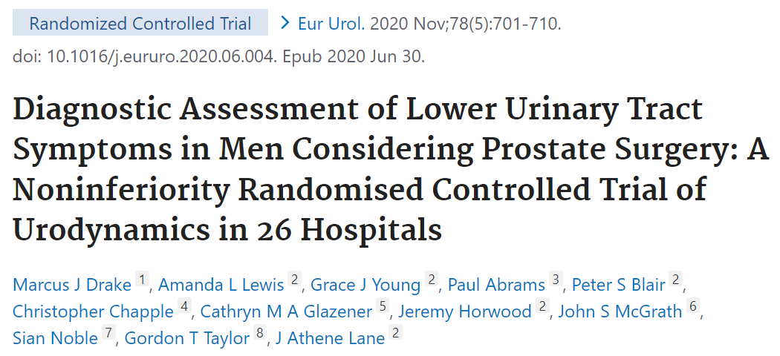
Male LUTS: Diagnostic Evaluation (1/2)
Section 4.12 Urodynamics¹
UPSTREAM study²
Routine diagnostic tests
Theory
By distinguishing BOO and DU with UDS, unnecessary surgery can be reduced²
Result (18 months after randomization)²
IPSS (primary outcome): Non-inferior
Surgery rates (key secondary outcome): No significant difference
Routine diagnostic tests
+ urodynamics
BOO, bladder outlet obstruction; DU, detrusor underactivity; LUTS, lower urinary tract symptoms; UDS, urodynamics. 1. EAU Guidelines on management of non-neurogenic male lower urinary tract symptoms (LUTS), incl. benign prostatic obstruction (BPO). European Association of Urology. 2022. Available at: https://d56bochluxqnz.cloudfront.net/documents/full-guideline/EAU-Guidelines-on-Non-Neurogenic-Male-LUTS-2023.pdf. Accessed 8 March 2023. 2. Drake MJ, et al. Eur Urol. 2020 Nov;78(5):701-710
Notes:
First is the update of the diagnostic method. One piece of evidence has been added to the Urodynamics section. According to the content, “It is not necessary to perform UDS on all patients before prostate surgery.” What does this mean?

Slide 9
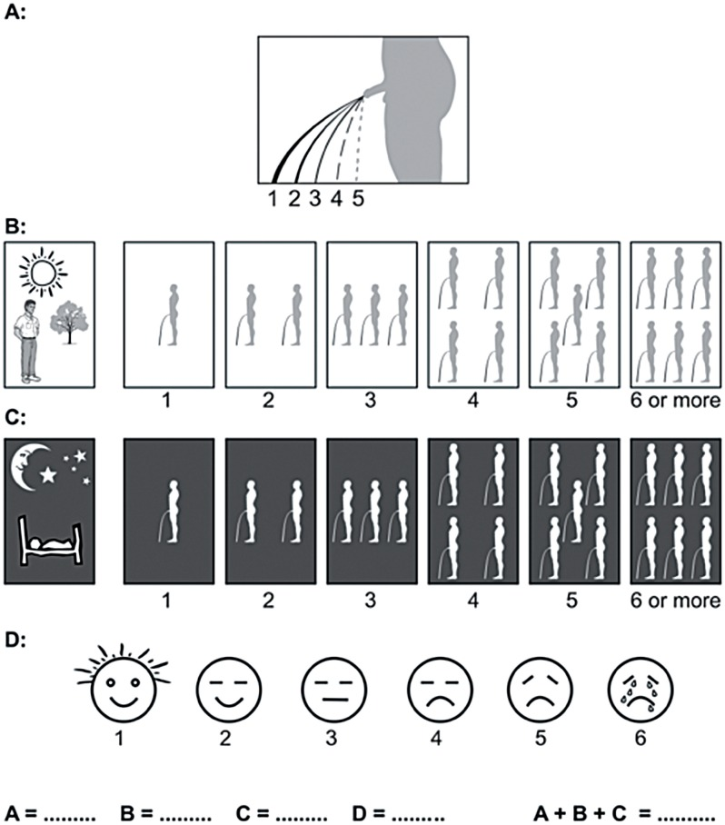
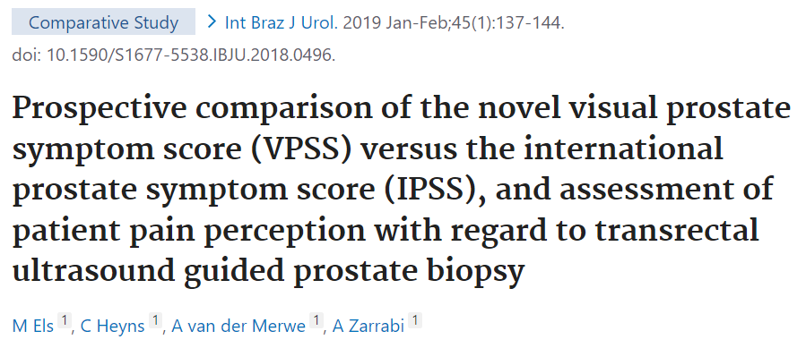
Male LUTS: Diagnostic Evaluation (2/2)
Section 4.14 Novel assessment¹
4.14.1 Visual prostate symptom score (VPSS)¹
4.14.2 Micro-RNA¹
Statistically significant correlations between the VPSS and IPSS [correlation coefficient (r) = 0.802]²
IPSS, International Prostate Symptom Score; LUTS, lower urinary tract symptoms; RNA, ribonucleic acid. 1. EAU Guidelines on management of non-neurogenic male lower urinary tract symptoms (LUTS), incl. benign prostatic obstruction (BPO). European Association of Urology. 2022. Available at: https://d56bochluxqnz.cloudfront.net/documents/full-guideline/EAU-Guidelines-on-Non-Neurogenic-Male-LUTS-2023.pdf. Accessed 8 March 2023. 2. Els M, et al. Int Braz J Urol. 2019 Jan-Feb;45(1):137-144.
Notes:
And new diagnostic methods have been introduced. The first is the VPSS questionnaire. Do you remember IPSS? You can think of it as a visual representation of IPSS, and it looks like this. It is said that it was developed so that even people who cannot read can write by visually expressing the intensity of urine, the number of urinations during the day and night, and the quality of life. Micro-RNA is mainly used for the diagnosis of cancer, but it is said that it has the potential to be applied to benign prostatic hyperplasia.

Slide 10
Non-pharmacological disease management in LUTS
Conservative management and other therapies
Surgical intervention
Watchful waiting
For men with mild/moderate symptoms, minimally bothered by their symptoms
Behavioural and dietary modifications
For men with LUTS lifestyle advice and self-care information prior to, or concurrent with, treatment
Phytotherapy (plant extracts)
Cucurbita pepo L, semen (pumpkin seed)
Serenoa repens, fructus (saw palmetto, fruit)
Serenoa repens, fructus (saw palmetto, fruit)
Resection
Non-ablative techniques
Alternative ablative techniques
Enucleation
Vaporisation
LUTS, lower urinary tract symptoms. EAU Guidelines on management of non-neurogenic male lower urinary tract symptoms (LUTS), incl. benign prostatic obstruction (BPO). European Association of Urology. 2022. Available at: https://d56bochluxqnz.cloudfront.net/documents/full-guideline/EAU-Guidelines-on-Non-Neurogenic-Male-LUTS-2023.pdf. Accessed 8 March 2023.
Notes:
For patients who do not respond adequately to these conservative therapies, pharmacological therapy is often necessary, ranging from neuromodulative therapies such as antimuscarinics to chemodenervation therapies such as botulinum toxin.

Slide 11
Updates to the EAU guidelines for the management of non-neurogenic male LUTS: Conservative treatment
Section 5.1 Conservative treatment¹
5.1.2 Behavioral and dietary modifications¹
Summary of evidence Self-management achieved a clinically meaningful reduction in symptom severity at six months compared to usual care. There was also a small but significant additional benefit of adding self-management to drug therapy.
Analyses based on 8 studies among 1,006 adult men
(7 were judged to be at high risk in more than 1 domain of bias)²
IPSS reduction
vs. drug therapy: mean difference=0.0; 95% CI, –2.0 to 2.0; 3 studies²
Additional benefit to drug therapy: MD=–2.3; 95% CI, –4.1 to –0.5; 1 study²
EAU, European Association of Urology; IPSS, International Prostate Symptom Score; LUTS, lower urinary tract symptoms. 1. EAU Guidelines on management of non-neurogenic male lower urinary tract symptoms (LUTS), incl. benign prostatic obstruction (BPO). European Association of Urology. 2022. Available at: https://d56bochluxqnz.cloudfront.net/documents/full-guideline/EAU-Guidelines-on-Non-Neurogenic-Male-LUTS-2023.pdf. Accessed 8 March 2023. 2. Albarqouni L, et al. Ann Fam Med. 2021;19(2):157-167.

Slide 12
Pharmacological disease management in LUTS¹
α1-adrenoceptor antagonists
For men with moderate-to-severe LUTS
5α-reductase inhibitors
For men with moderate-to-severe LUTS and at risk of disease progression (prostate volume >40 mL)
Muscarinic receptor antagonists
For men with moderate-to-severe LUTS with mainly bladder storage symptoms
Not recommended in OAB with a post-void residual volume (PVR) >150 mL
β-3 agonist
For men with moderate-to-severe LUTS with mainly bladder storage symptoms
Phosphodiesterase 5 inhibitors
For men with moderate-to-severe LUTS with or without erectile dysfunction
Alfuzosin, doxazosin, silodosin, tamsulosin, terazosin, naftopidil
Dutasteride, finasteride
Darifenacin, fesoterodine, oxybutynin, propiverine, solifenacin, tolterodine, trospium chloride
Mirabegron
Tadalafil
LUTS, lower urinary tract symptoms. 1. EAU Guidelines on management of non-neurogenic male lower urinary tract symptoms (LUTS), incl. benign prostatic obstruction (BPO). European Association of Urology. 2022. Available at: https://d56bochluxqnz.cloudfront.net/documents/full-guideline/EAU-Guidelines-on-Non-Neurogenic-Male-LUTS-2023.pdf. Accessed 8 March 2023.
Notes:
Key classes of pharmacological treatments recommended for the treatment of male LUTS

Slide 13
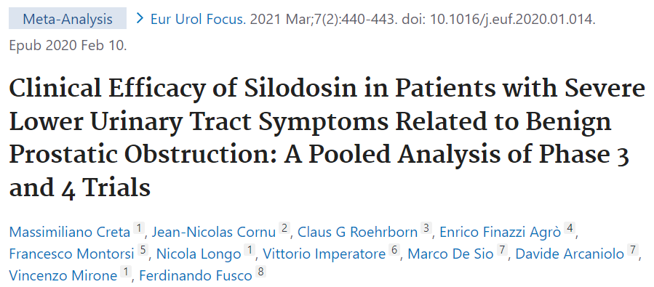
Updates to the EAU guidelines for the management of non-neurogenic male LUTS: Pharmacological treatment
Section 5.2 Pharmacological treatment¹
5.2.1 α1-Adrenoceptor antagonists (α1-blockers)¹
Efficacy:
Prostate size does not affect α1-blocker efficacy in studies with follow-up periods of less than one year, but α1-blockers do seem to be more efficacious in patients with smaller prostates (<40 mL) in longer-term studies. The efficacy of α1-blockers is similar across age groups¹.
A pooled analysis of phase III and IV trials of silodosin 8 mg demonstrated that improvements in total, storage, voiding, and QoL IPSS scores were similar for the severe and not severe LUTS cohorts¹.
Two or more of the following criteria was adopted to define severity²:
Total IPSS 20-35
QoL score 5-6
Q_{max} <5ml/s or PVR volume ≥100ml
Prostate volume ≥50ml
EAU, European Association of Urology; IPSS, International Prostate Symptom Score; LUTS, lower urinary tract symptoms; QoL, quality of life; Q_{max}, maximum urinary flow; PVR, post void residual volume. 1. EAU Guidelines on management of non-neurogenic male lower urinary tract symptoms (LUTS), incl. benign prostatic obstruction (BPO). European Association of Urology. 2022. Available at: https://d56bochluxqnz.cloudfront.net/documents/full-guideline/EAU-Guidelines-on-Non-Neurogenic-Male-LUTS-2023.pdf. Accessed 8 March 2023. 2. Creta M, et al. Eur Urol Focus. 2021 Mar;7(2):440-443.

Slide 14
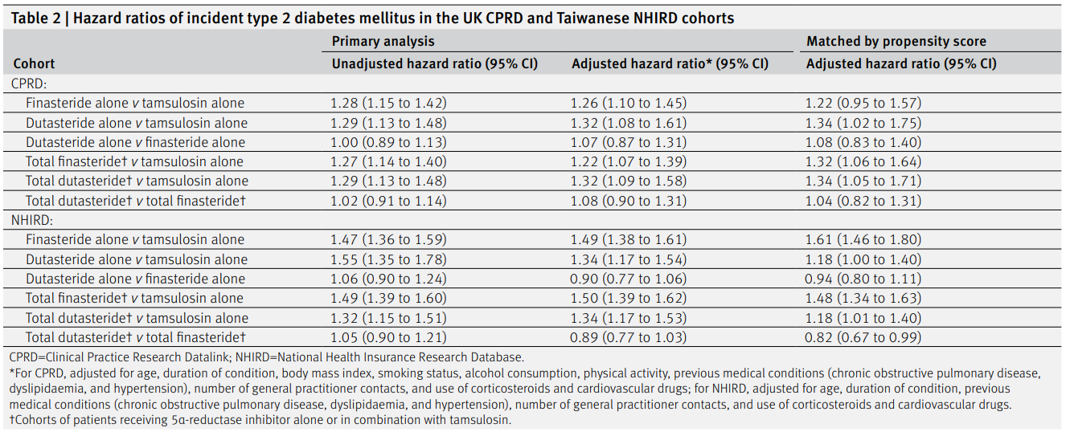
Updates to the EAU guidelines for the management of non-neurogenic male LUTS: Pharmacological treatment
Section 5.2 Pharmacological treatment¹
5.2.2 5α-reductase inhibitors¹
Tolerability and safety:
In a British-Taiwanese population-based cohort study, the risk of type II diabetes was higher in men with 5α-reductase inhibitors than in men receiving tamsulosin but did not differ between dutasteride and finasteride¹.
Hazard ratios of incident type 2 diabetes mellitus in the UK CPRD and Taiwanese NHIRD cohorts²
CI, confidence interval; EAU, European Association of Urology; IPSS, International Prostate Symptom Score; LUTS, lower urinary tract symptoms; NHIRD, National Health Insurance Research Database; QoL, quality of life; Q_{max}, maximum urinary flow; PVR, post void residual volume; UK CPRD, UK Clinical Practice Research Datalink. 1. EAU Guidelines on management of non-neurogenic male lower urinary tract symptoms (LUTS), incl. benign prostatic obstruction (BPO). European Association of Urology. 2022. Available at: https://d56bochluxqnz.cloudfront.net/documents/full-guideline/EAU-Guidelines-on-Non-Neurogenic-Male-LUTS-2023.pdf. Accessed 8 March 2023. 2. Wei L, et al. BMJ. 2019 Apr 10;365:l1204.

Slide 15
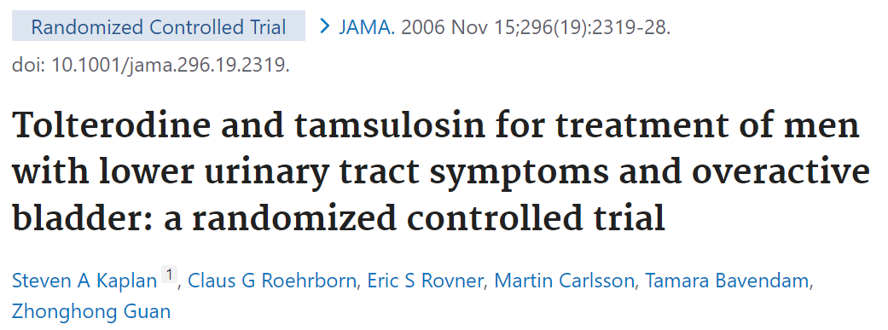
Updates to the EAU guidelines for the management of non-neurogenic male LUTS: Pharmacological treatment
Section 5.2 Pharmacological treatment¹
5.2.3 Muscarinic receptor antagonists¹
Efficacy:
(Deleted) A significantly greater proportion of patients in the tolterodine ER plus tamsulosin group reported treatment benefit compared with the other three treatment groups.
5.2.7 Combination therapies¹
EAU, European Association of Urology; LUTS, lower urinary tract symptoms. 1. EAU Guidelines on management of non-neurogenic male lower urinary tract symptoms (LUTS), incl. benign prostatic obstruction (BPO). European Association of Urology. 2022. Available at: https://d56bochluxqnz.cloudfront.net/documents/full-guideline/EAU-Guidelines-on-Non-Neurogenic-Male-LUTS-2023.pdf. Accessed 8 March 2023. 2. Kaplan SA, et al. JAMA. 2006;296(19):2319-28.

Slide 16
Inadequate management of LUTS with α1-adrenoreceptor antagonists
α1-blockers are guideline-recommended first-line pharmacotherapy for male LUTS and benign prostatic hyperplasia (BPH), regardless of prostate size¹
However, failure to improve storage symptoms, including OAB, is commonly observed with first-line treatment of LUTS with α1-adrenoceptor antagonists¹
Combination of a α1-blocker and antimuscarinic in patients with moderate-to-severe LUTS with insufficient relief of storage symptoms with monotherapy with either drug is guideline-recommended, except in case of PVR >150 mL²
LUTS, lower urinary tract symptoms; OAB, overactive bladder; PVR, post void residual volume. 1. Kakizaki H et al. Eur Urol Focus. 2020;15;6(4):729-737. 2. EAU Guidelines on management of non-neurogenic male lower urinary tract symptoms (LUTS), incl. benign prostatic obstruction (BPO). European Association of Urology. 2022. Available at: https://d56bochluxqnz.cloudfront.net/documents/full-guideline/EAU-Guidelines-on-Non-Neurogenic-Male-LUTS-2023.pdf. Accessed 8 March 2023.

Slide 17
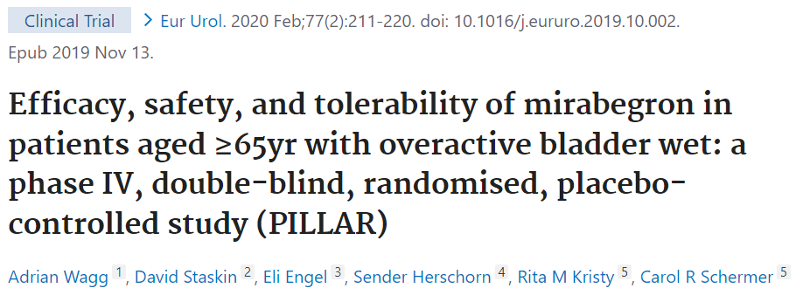
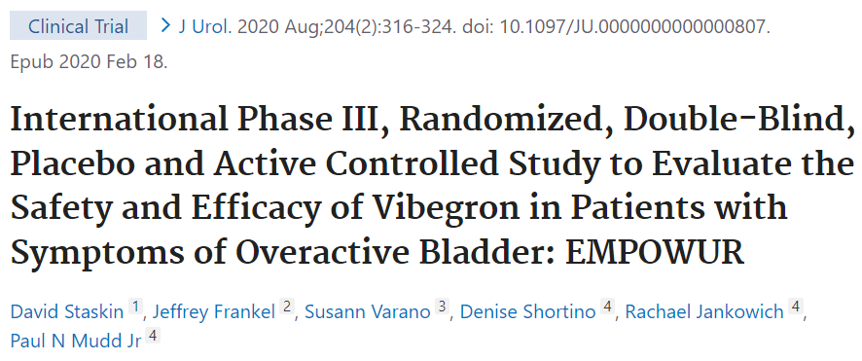
Updates to the EAU guidelines for the management of non-neurogenic male LUTS: Pharmacological treatment
Section 5.2 Pharmacological treatment¹
5.2.4 Beta-3 agonist¹
Efficacy:
(Moved to 5.2.7.3) Silodosin + fesoterodine vs. silodosin + mirabegron (add-on)
(Moved to 5.2.7.3 & replaced by newer data) Tamsulosin + mirabegron (add-on)
Tolerability and safety:
The phase III EMPOWUR trial comparing vibegron to placebo and tolterodine showed once daily 75 mg vibegron provided statistically significant reductions in micturitions, urgency episodes and UUI³. Treatment was well tolerated with a favourable safety profile³. However, the majority of the study population (85%) were female and vibegron is not yet licensed in Europe³.
The PILLAR phase IV study also showed that in a large population of 888 patients > 65 years (approx. 30% of males), mirabegron 50 mg was safe and effective².
EAU, European Association of Urology; LUTS, lower urinary tract symptoms. 1. EAU Guidelines on management of non-neurogenic male lower urinary tract symptoms (LUTS), incl. benign prostatic obstruction (BPO). European Association of Urology. 2022. Available at: https://d56bochluxqnz.cloudfront.net/documents/full-guideline/EAU-Guidelines-on-Non-Neurogenic-Male-LUTS-2023.pdf. Accessed 8 March 2023. 2. Wagg A, et al. Eur Urol. 2020;77(2):211-220. 3. Staskin D, et al. J Urol. 2020;204(2):316-324.
Notes:
PILLAR study will be described in more details within the next slides

Slide 18
PILLAR Study: Study design and population
Phase 4, double-blind, randomized, placebo-controlled study (103 sites) across the USA and Canada
3-day micturition diaries completed at baseline and before Week 4, 8, and 12 (EoT) visit
Based on the 3-day micturition diary completed at baseline, OAB patients experiencing the following symptoms were randomized 1:1 to mirabegron/placebo, stratified by age <75/≥75 years
≥1 incontinence episode
≥3 urgency episodes (PPIUS grade 3 or 4)
≥8 micturitions/24 hours on average
Mirabegron, flexible dosing regimen
25 mg with option to titrate to 50 mg at week 4 or 8
Placebo
V1 Screening | V2 | V3 Randomization | V4 Week 4 | V5 Week 8 | V6 Week 12/EoT | V7 Week 16
Placebo run-in (2 weeks)
Treatment period
(12 weeks)
Follow-up phone call
(4 weeks after EoT)
Note: The study was powered for superiority of total mirabegron over placebo
EoT, end of treatment; OAB, overactive bladder syndrome; PPIUS, Patient Perception of Intensity of Urgency Scale; V, visit. Wagg A, et al. Eur Urol. 2020;77(2):211-220.
Notes:
Sources: adapted from CSR page 21 and p137 last paragraph and Wagg A et al., (2019) Eur Urol. https://doi.org/ 10.1016/j.eururo.2019.10.002 Figure 1

Slide 19
Change in mean number of incontinence episodes and micturitions/24 h (FAS-I)
Incontinence episodes/24 h
Micturitions/24 h
Placebo 3.4 (0.2)
n=430
Mirabegron total 3.5 (0.2)
n=437
Placebo 10.5 (0.1)
n=430
Mirabegron total 10.6 (0.1)
n=437
Baseline, mean (SE):
Baseline, mean (SE):
-1.7
-1.5
Difference (SE): -0.6 (0.1)
P<0.001
Difference (SE): -0.7 (0.2)
P<0.001
Adjusted mean changes generated from ANCOVA models with treatment group, sex, age group (<75 or ≥75 years), and country as fixed factors and baseline value as a covariate.
ANCOVA, analysis of covariance; EoT, end of treatment; FAS-I, full analysis set incontinence; SE, standard error. Wagg A, et al. Eur Urol. 2020;77(2):211-220.
Notes:
Sources: CSR Tables 10 and 11 and Wagg A et al., (2019) Eur Urol. https://doi.org/ 10.1016/j.eururo.2019.10.002 Figure 3

Slide 20
Change in mean number of micturitions/24h by treatment group (FAS-I)
Placebo 10.5 (0.1)
n=430
Mirabegron 25 mg 10.7 (0.2)
n=220
Mirabegron 50 mg 10.5 (0.2)
n=217
Mirabegron total 10.6 (0.1)
n=437
Baseline, mean (SE):
-1.7
P=0.705 versus placebo*
P<0.001 versus placebo
P<0.001 versus placebo*
Adjusted mean changes generated from ANCOVA models with treatment group, sex, age group (<75 or ≥75 years), and country as fixed factors and baseline value as a covariate.
* The study was not powered to compare the separate mirabegron doses versus placebo.
ANCOVA, analysis of covariance; EoT, end of treatment; FAS-I, full analysis set incontinence; SE, standard error. Wagg A, et al. Eur Urol. 2020;77(2):211-220.
Notes:
Sources: CSR Table 10 and Wagg A et al., (2019) Eur Urol. https://doi.org/ 10.1016/j.eururo.2019.10.002 Figure 4A

Slide 21
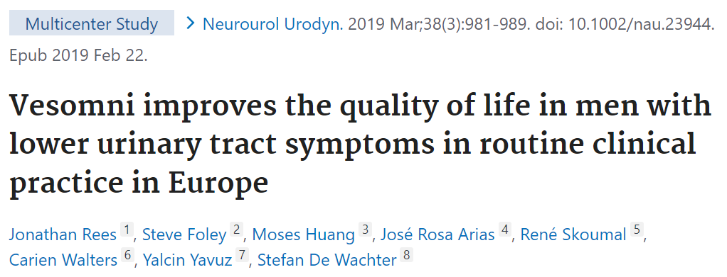
Updates to the EAU guidelines for the management of non-neurogenic male LUTS: Pharmacological treatment
Section 5.2 Pharmacological treatment¹
5.2.7 Combination therapies¹
5.2.7.2 α1-blockers + muscarinic receptor antagonists¹
Efficacy:
The intake of fixed-dose combination tablet containing solifenacin 6 mg and tamsulosin 0.4 mg improved OAB-q symptom bother in > 80% of LUTS/BPH patients not adequately responding to monotherapy, with a high treatment persistence (77% at weeks 40 to 52), and a low risk of AUR¹.
EAU, European Association of Urology; LUTS, lower urinary tract symptoms. 1. EAU Guidelines on management of non-neurogenic male lower urinary tract symptoms (LUTS), incl. benign prostatic obstruction (BPO). European Association of Urology. 2022. Available at: https://d56bochluxqnz.cloudfront.net/documents/full-guideline/EAU-Guidelines-on-Non-Neurogenic-Male-LUTS-2023.pdf. Accessed 8 March 2023. 2. Rees J, et al. Neurourol Urodyn. 2019;38(3):981-989.

Slide 22
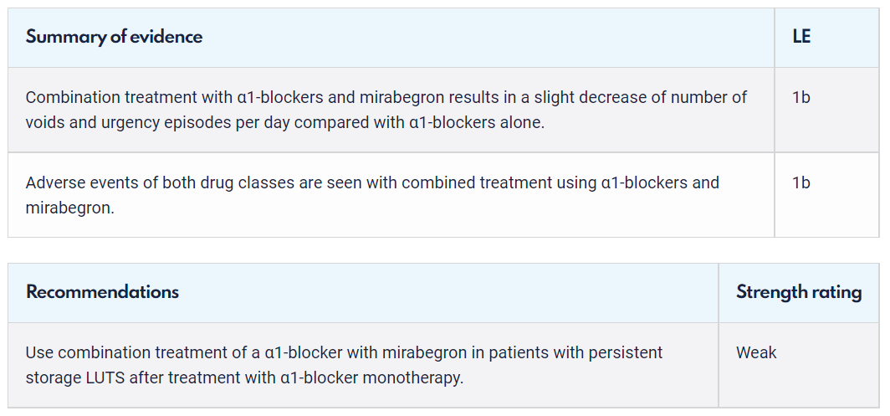
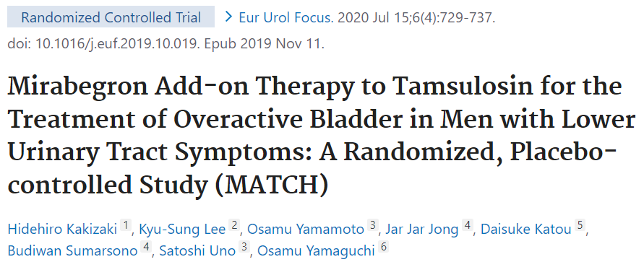
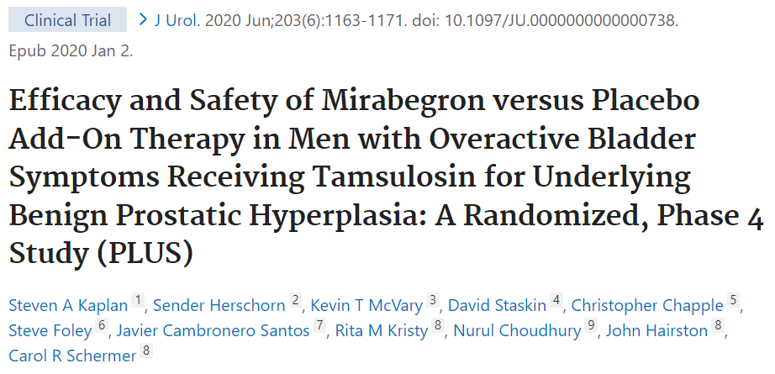
Updates to the EAU guidelines for the management of non-neurogenic male LUTS: Pharmacological treatment
Section 5.2 Pharmacological treatment¹
New
Chapter
5.2.7 Combination therapies¹
5.2.7.3. α1-blockers + Beta-3 agonist¹
MATCH study²
Tamsulosin 0.2 mg + mirabegron 50 mg (12-week)
568 men in Korea and Japan
PLUS study³
Tamsulosin 0.4 mg + mirabegron 25-50 mg (12-week)
676 men in US, Canada, and Europe
EAU, European Association of Urology; LUTS, lower urinary tract symptoms. 1. EAU Guidelines on management of non-neurogenic male lower urinary tract symptoms (LUTS), incl. benign prostatic obstruction (BPO). European Association of Urology. 2022. Available at: https://d56bochluxqnz.cloudfront.net/documents/full-guideline/EAU-Guidelines-on-Non-Neurogenic-Male-LUTS-2023.pdf. Accessed 8 March 2023. 2. Kakizaki H et al. Eur Urol Focus. 2020;15;6(4):729-737. 3. Kaplan SA, et al. J Urol. 2020 Jun;203(6):1163-1171.
Notes:
The latest updates to the EAU guidelines for the management of male non-neurogenic LUTS including BPO, has included a new chapter recommending a combination of antimuscarinics and mirabegron for the patients with persistent LUTS symptoms following alpha1-blocker monotherapy
This update is based on the MATCH and PLUS clinical trials.

Slide 23
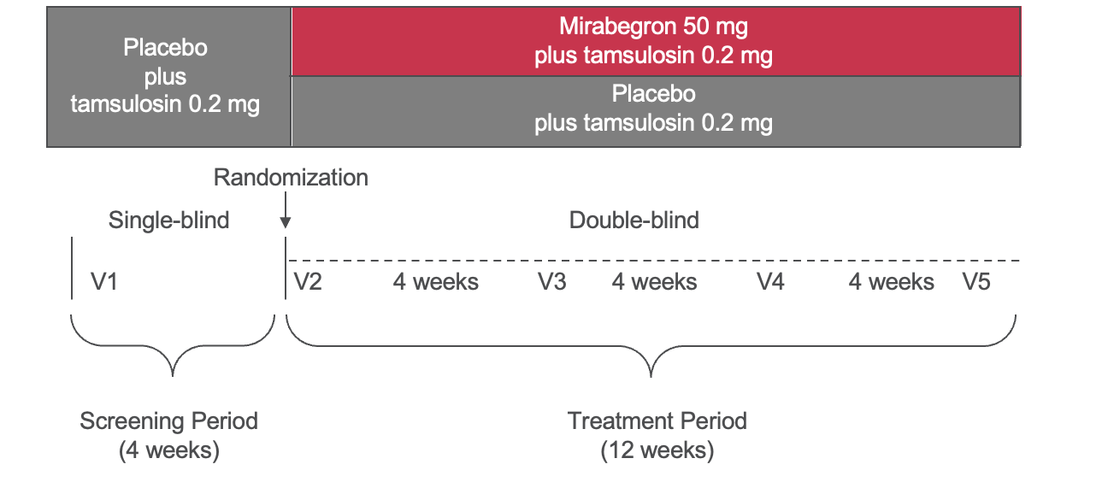
Updates to the EAU guidelines for the management of non-neurogenic male LUTS: MATCH study
Phase 4, double-blind, randomized, placebo-controlled study
Conducted in Japan (53 centers) and Korea (5 centers)
Male patients with OAB treated with the α-blocker tamsulosin for BPH were randomized 1:1 to mirabegron 50 mg or placebo plus tamsulosin (0.2 mg) for 12 weeks
BPH, benign prostatic hyperplasia; EAU, European Association of Urology; LUTS, lower urinary tract symptoms; OAB, overactive bladder; V, visit Kakizaki H et al. Eur Urol Focus. 2020;15;6(4):729-737.
Notes:
Sources: CSR page 13 and 14, figure 1 and Kakizaki H et al., (2019) Eur Urol Focus, https://doi.org/10.1016/j.euf.2019.10.019 Supplementary Information Figure 1

Slide 24
Primary endpoint: change in mean number of micturitions/24 h (FAS)
Placebo 10.76 (2.36)
n=283
Mirabegron 50 mg 10.40 (2.24)
n=282
Baseline, mean (SD):
Adjusted mean difference (95%CI): -0.52 (-0.82 to -0.21)
P<0.001, by ANCOVA
ANCOVA, analysis of covariance; CI, confidence interval; EoT, end of treatment; FAS, full analysis set; SD, standard deviation. Kakizaki H et al. Eur Urol Focus. 2020;15;6(4):729-737.
Notes:
Sources: CSR page 302, table 12.3.1.1.1 and Kakizaki H et al., (2019) Eur Urol Focus, https://doi.org/10.1016/j.euf.2019.10.019 Figure 2

Slide 25
Percentage of subjects achieving normalization of micturition (FAS)
Normalization was defined as mean number of micturition episodes per 24 hours of <8
(95% CI: 14.19% to 23.63%)
18.57%
52/280
Placebo n=280
Mirabegron 50 mg n=277
CI, confidence interval; FAS, full analysis set.
Kakizaki H et al. Eur Urol Focus. 2020;15;6(4):729-737.
Notes:
Source: CSR Page 61, table 24

Slide 26
Treatment emergent adverse events (SAF)
Event*, n (%) | Placebo (n=284) | Mirabegron 50 mg (n=282)
TEAEs | 64 (22.5) | 66 (23.4)
Drug-related† TEAEs | 18 (6.3) | 11 (3.9)
Deaths | 0 | 0
Serious TEAEs | 3 (1.1) | 6 (2.1)
Drug-related† serious TEAEs | 1 (0.4) | 0
TEAEs leading to discontinuation of study drug | 4 (1.4) | 4 (1.4)
Drug-related† TEAEs leading to discontinuation of study drug | 3 (1.1) | 0
TEAEs^{ǂ} by severity
Mild | 57 (20.1) | 56 (19.9)
Moderate | 6 (2.1) | 8 (2.8)
Severe | 1 (0.4) | 2 (0.7)
*Per MedDRA version 18.1. †A possible or probable, as assessed by the investigator, or records where relationship with the study drug for the treatment period was unknown. Drug-related TEAEs with assessment of the causal relationship to mirabegron/placebo are presented. ^{ǂ}Patient counted once under maximum severity. A missing severity was considered the maximum severity. SAF, safety analysis set; TEAE, treatment-emergent adverse event. Kakizaki H et al. Eur Urol Focus. 2020;15;6(4):729-737.
Notes:
Sources: CSR Page 65, table 27 and Kakizaki H et al., (2019) Eur Urol Focus, https://doi.org/10.1016/j.euf.2019.10.019 Table 2

Slide 27
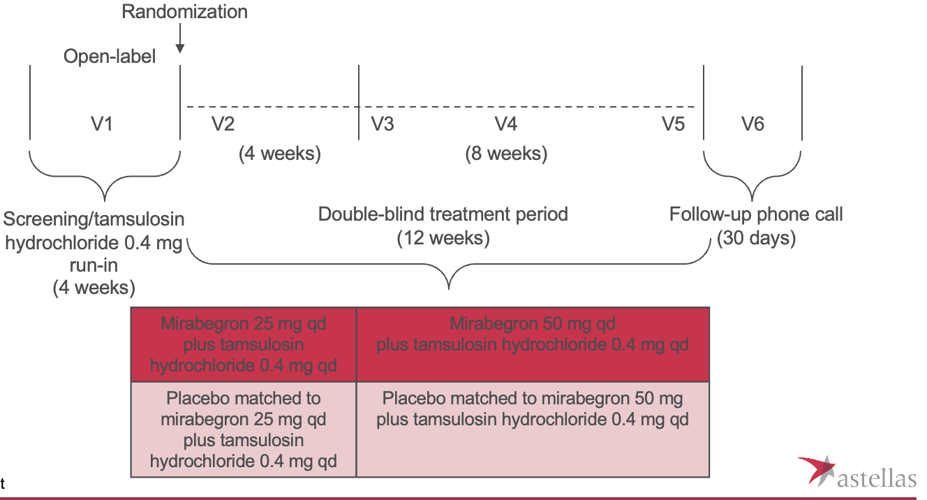
Updates to the EAU guidelines for the management of non-neurogenic male LUTS: PLUS study
Phase 4, double-blind, randomized, placebo-controlled study
After screening, patients entered into a 4-week open label tamsulosin 0.4 mg once-daily run-in period before being randomized into the 12-week double-blind treatment period
EAU, European Association of Urology; LUTS, lower urinary tract symptoms; qd, once-daily. Kaplan SA, et al. J Urol. 2020 Jun;203(6):1163-1171.
Notes:
Source: page 20, figure 1

Slide 28
Change from baseline to EoT in mean number of micturitions per day (FAS)
Placebo 10.71 (0.14)
n=339
Mirabegron 10.71 (0.14)
n=337
Baseline, mean (SE):
The primary efficacy endpoint demonstrated a -2.00 decrease in micturition in the mirabegron/tamsulosin group compared to -1.62 in the placebo/tamsulosin group, which was statistically significant
Adjusted mean difference (95%CI): -0.39 (-0.76 to -0.02)
P=0.039, by ANCOVA
ANCOVA, analysis of covariance; CI, confidence interval; EoT, end of treatment; FAS, full analysis set; LS, least square; SE, standard error. Kaplan SA, et al. J Urol. 2020 Jun;203(6):1163-1171.
Notes:
Source: page 57, table 5

Slide 29
Change from baseline in mean number of micturitions per day at weeks 8 and 12 (FAS)
The mean number of daily micturitions, at weeks 8 and 12, was significantly improved in the mirabegron/tamsulosin group compared to the placebo/tamsulosin group
WEEK 8
WEEK 12
Placebo 10.71 (0.14)
n=326
Mirabegron 10.71 (0.14)
n=328
Placebo 10.71 (0.14)
n=319
Mirabegron 10.71 (0.14)
n=317
Baseline, mean (SE):
Baseline, mean (SE):
Adjusted mean difference (95%CI): -0.52 (-0.89 to -0.14)
P=0.007, by ANCOVA
Adjusted mean difference (95%CI): -0.39 (-0.76 to -0.02)
P=0.041, by ANCOVA
ANCOVA, analysis of covariance; CI, confidence interval; FAS, full analysis set; LS, least square; SE, standard error
Kaplan SA, et al. J Urol. 2020 Jun;203(6):1163-1171.
Notes:
Source: page 60, table 6

Slide 30
Treatment emergent adverse events (SAF)
Event*, n (%) | Placebo (n=354) | Mirabegron (n=352)
Any TEAE | 111 (31.4) | 91 (25.9)
Drug-related† TEAEs | 21 (5.9) | 42 (11.9)
Deaths | 0 | 0
Serious TEAEs^{ǂ} | 8 (2.3) | 10 (2.8)
Drug-related† serious TEAEs | 1 (0.3) | 2 (0.6)
TEAEs leading to permanent discontinuation of study drug | 4 (1.1) | 7 (2.0)
Drug-related† TEAEs leading to permanent discontinuation of study drug | 2 (0.6) | 6 (1.7)
The SAF included all randomized patients who took ≥1 dose of double‑blind study drug. TEAE refers to an adverse event which started or worsened in the period from first double-blind medication intake until 30 days after the last double-blind medication intake. Serious TEAEs with a start date reported until 30 days after the last double-blind medication intake were also summarized as TEAEs. *Per MedDRA version 18.1. †Possible or probable, as assessed by the investigator or records where relationship was missing. ^{ǂ}Included SAEs upgraded by the sponsor based on review of the sponsor’s list of always serious terms, if any upgrade was done. SAE, serious adverse event; SAF, safety analysis set; TEAE, treatment-emergent adverse event Kaplan SA, et al. J Urol. 2020 Jun;203(6):1163-1171.
Notes:
Source: Page 78, table 23

Slide 31
Antimuscarinics are effective against LUTS but must be used with caution
Antimuscarinics is recommended for use in men with moderate-to-severe LUTS who mainly have bladder storage symptoms¹
However, antimuscarinics cannot be used in men with a PVR volume >150 mL²
Caution must prevail in using long-term antimuscarinic treatment in elderly patients and especially those at risk of cognitive dysfunction³
Treatment with antimuscarinics is typically associated with frequent adverse events (dry mouth, constipation) and risk of urinary retention³
LUTS, lower urinary tract symptoms; PVR, postvoid residual. 1. Kakizaki H et al. Eur Urol Focus. 2020;15;6(4):729-737. 2. EAU Guidelines on management of non-neurogenic male lower urinary tract symptoms (LUTS), incl. benign prostatic obstruction (BPO). European Association of Urology. 2022. Available at: https://d56bochluxqnz.cloudfront.net/documents/full-guideline/EAU-Guidelines-on-Non-Neurogenic-Male-LUTS-2023.pdf. Accessed 8 March 2023. 3. EAU Guidelines on Urinary Incontinence in Adults. European Association of Urology. 2020. Available at: https://d56bochluxqnz.cloudfront.net/media/EAU-Guidelines-on-Urinary-Incontinence-2020.pdf. Accessed 10 March 2023.

Slide 32
Updates to the EAU guidelines for the management of non-neurogenic male LUTS: Pharmacological treatment
Section 5.2 Pharmacological treatment¹
5.2.5 Phosphodiesterase 5 inhibitors¹
Tolerability and safety:
Detailed information regarding tolerability/safety of all available PDE5Is for the treatment of ED in men treated with α-blockers for LUTS are provided by the EAU Guidelines on Sexual and Reproductive Health².
“A recent meta-analysis concluded that a concomitant treatment with α-blockers [both non-uroselective (e.g., terazosin and doxazosin) and uro-selective (e.g., alfuzosin, tamsulosin and silodosin)] and PDE5Is may produce changes in haemodynamic parameters, but it does not increase the rate of adverse events due to hypotension. Therefore, there is no current limitation in the simultaneous use of α-blockers and PDE5I, prioritising the use of uro-selective drugs in order to further minimise the risk of dizziness or other adverse events, thus including hypotension².”
EAU, European Association of Urology; LUTS, lower urinary tract symptoms; PDE5I, phosphodiesterase 5 inhibitor. 1. EAU Guidelines on management of non-neurogenic male lower urinary tract symptoms (LUTS), incl. benign prostatic obstruction (BPO). European Association of Urology. 2022. Available at: https://d56bochluxqnz.cloudfront.net/documents/full-guideline/EAU-Guidelines-on-Non-Neurogenic-Male-LUTS-2023.pdf. Accessed 8 March 2023. 2. EAU Guidelines on sexual and reproductive health. European Association of Urology. 2023. Available at: https://d56bochluxqnz.cloudfront.net/documents/full-guideline/EAU-Guidelines-on-Sexual-and-Reproductive-Health-2023.pdf. Accessed 10 March 2023.

Slide 33
Updates to the EAU guidelines for the management of non-neurogenic male LUTS: Pharmacological treatment
Section 5.2 Pharmacological treatment
5.2.6 Plant extracts – phytotherapy
The Committee on Herbal Medicinal Products (HPMC) periodically invites all interested parties to submit any scientific data that the Committee should consider during their periodic review of the monographs.
2021 review result: No changes; Only hexane extracted Serenoa repens (HESr) has been recommended for well-established use by the HMPC.
EAU, European Association of Urology; LUTS, lower urinary tract symptoms. EAU Guidelines on management of non-neurogenic male lower urinary tract symptoms (LUTS), incl. benign prostatic obstruction (BPO). European Association of Urology. 2022. Available at: https://d56bochluxqnz.cloudfront.net/documents/full-guideline/EAU-Guidelines-on-Non-Neurogenic-Male-LUTS-2023.pdf. Accessed 8 March 2023.

Slide 34
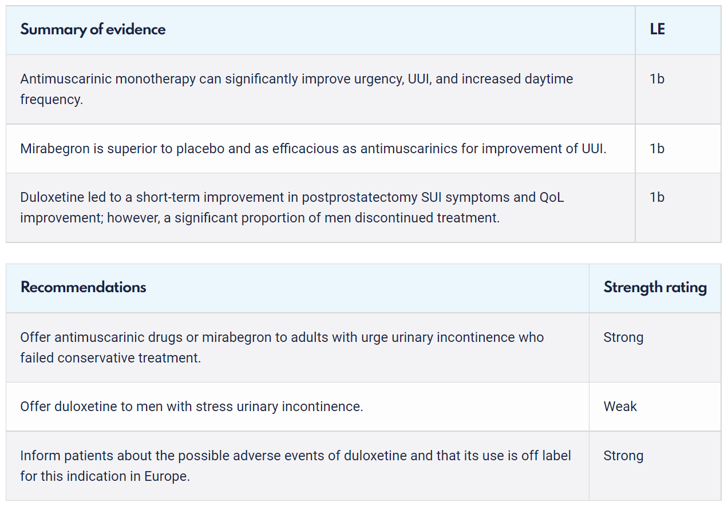
Updates to the EAU guidelines for the management of non-neurogenic male LUTS: Pharmacological treatment
Section 5.6 Management of male urinary incontinence
5.6.4 Pharmacological management
New
Chapter
New
Chapter
EAU, European Association of Urology; LUTS, lower urinary tract symptoms. EAU Guidelines on management of non-neurogenic male lower urinary tract symptoms (LUTS), incl. benign prostatic obstruction (BPO). European Association of Urology. 2022. Available at: https://d56bochluxqnz.cloudfront.net/documents/full-guideline/EAU-Guidelines-on-Non-Neurogenic-Male-LUTS-2023.pdf. Accessed 8 March 2023.

Slide 35
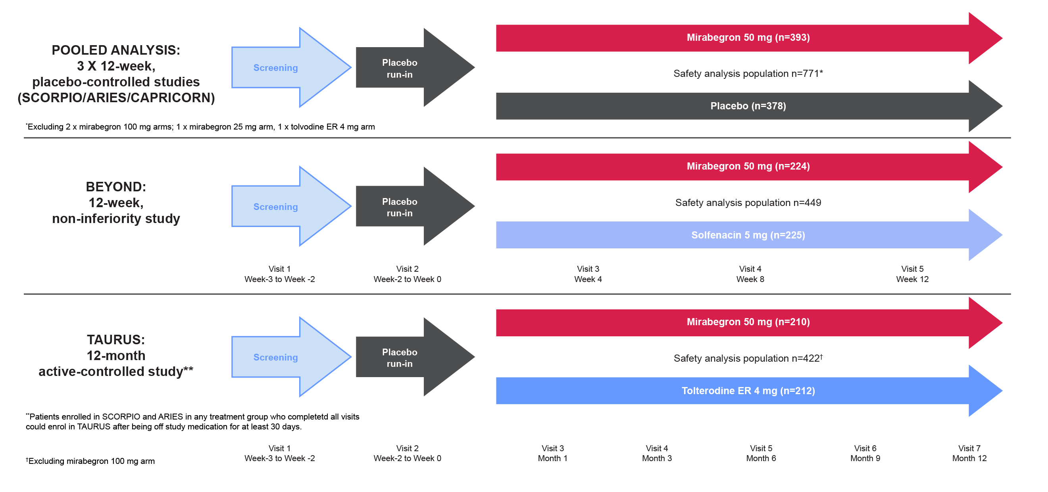
Mirabegron in male OAB patients with or without LUTS – POOLED analysis of phase III trials
Study population: Male OAB population with or without LUTS associated with BPH/BPE
Intervention: Mirabegron 50 mg vs placebo or antimuscarinic (tolterodine extended-release 4 mg or solifenacin 5 mg) as a comparator
5 Phase III studies
Similar improvements in urgency, frequency, and incontinence as solifenacin 5 mg
Mirabegron 50 mg is a well-tolerated alternative to antimuscarinics
BPE, benign prostatic enlargement; BPH, benign prostate hyperplasia; LUTS, lower urinary tract symptoms; OAB, overactive bladder. Tubaro A, et al. Ther Adv Urol. 2017;9(6):137-154
Notes:
Before we discuss the MATCH and PLUS trials, let us look at the efficacy and safety of mirabegron in the management of LUTS/OAB

Slide 36
Mirabegron in male OAB patients with or without LUTS – TEAE
Overall incidence of TEAEs
 | Pooled studies (12 weeks) (SCORPIO/ARIES/CAPRICORN) |  | TAURUS (52 weeks) |  | BEYOND (12 weeks)
TEAE (preferred term), n (%) | Placebo (n = 378) | Mirabegron 50 mg (n = 393) | Mirabegron 50 mg (n = 210) | Tolterodine ER 4 mg (n = 212) | Mirabegron 50 mg (n = 224) | Solifenacin 5 mg (n = 225)
Overall TEAE in males, n (%) | 171/378 (45.2) | 181/393 (46.1) | 126/210 (60.0) | 132/212 (62.3) | 55/224 (24.5) | 59/225 (26.2)
TEAEs of special interest
Urinary retention, n (%) | 1 (0.3) | 1 (0.3) | 0 | 3 (1.4) | 1 (0.1) | 0
Acute urinary retention, n (%) | 1 (0.3) | 1 (0.3) | 0 | 1 (0.5) | 0 | 0
Incidence of TEAEs in men treated with mirabegron 50 mg was similar to the overall population and placebo, suggesting there is no requirement for dose adjustment based on sex
In the pooled studies, mirabegron was well tolerated, with the overall incidence of TEAEs similar to that with placebo
ER, extended release; LUTS, lower urinary tract symptoms; OAB, overactive bladder; TEAE, treatment emergent adverse event. Tubaro A, et al. Ther Adv Urol. 2017;9(6):137-154

Slide 37
Mirabegron in male OAB patients with or without LUTS – No increase in PVR volume or acute urinary retention
Change from baseline to EoT in PVR volume (pooled 12-week studies only) (SAF)
Males with a history of LUTS associated with BPH/BPE
Males without a history of LUTS associated with BPH/BPE
Mirabegron 50 mg is a well-tolerated alternative to antimuscarinics, without the potential concerns over voiding difficulty
In the pooled Phase III studies of all male OAB patients, there is no significant increase in PVR volume or incidence of acute urinary retention with mirabegron
BPE, benign prostatic enlargement; BPH, benign prostatic hyperplasia; CI, confidence interval; EoT, end of treatment; LUTS, lower urinary tract symptoms; OAB, overactive bladder; PVR, post-void residual. Tubaro A, et al. Ther Adv Urol. 2017;9(6):137-154

Slide 38
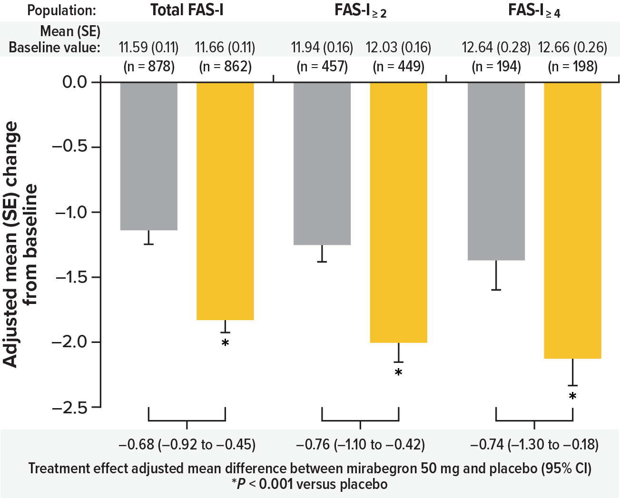
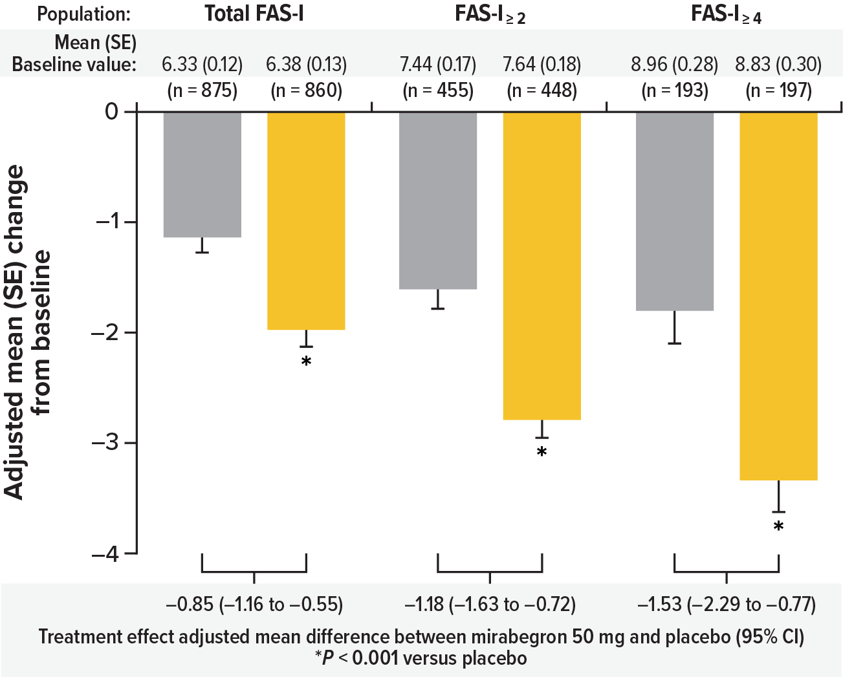
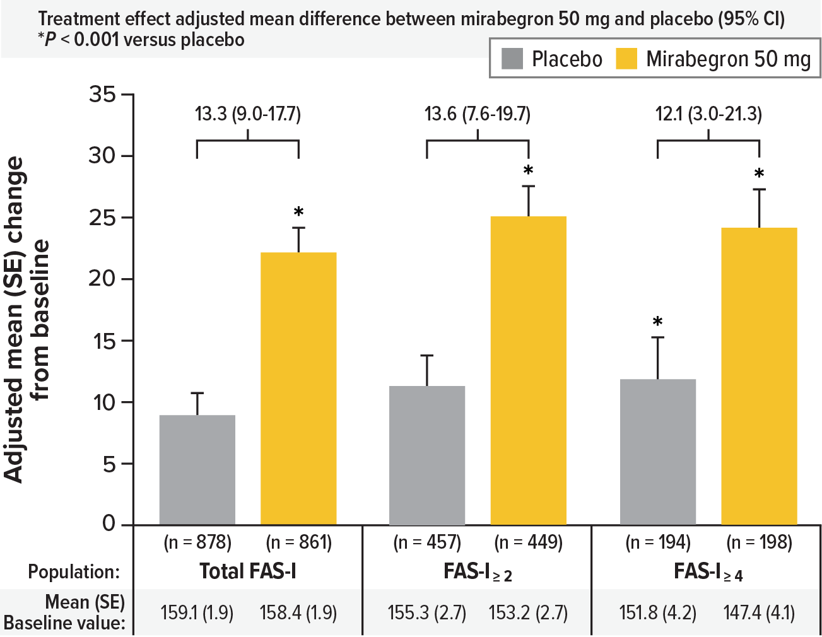
Efficacy of mirabegron vs placebo
Number of micturitions per 24 hours
Number of urgency episodes per 24 hours
Volume voided per micturition (mL)
CI, confidence interval; FAS-I, full analysis set incontinence (≥ 1 incontinence episode at baseline); FAS-I ≥ 2, two or more incontinence episodes at baseline; FAS-I ≥ 4, four or more incontinence episodes at baseline; SE, standard error. Chapple C, et al. Eur Urol. 2015;67(1):11-4.
Notes:
Chapple C, Khullar V, Nitti VW, Frankel J, Herschorn S, Kaper M, et al. Efficacy of the β₃-adrenoceptor agonist mirabegron for the treatment of overactive bladder by severity of incontinence at baseline: a post hoc analysis of pooled data from three randomised phase 3 trials. Eur Urol. 2015;67(1):11-4.

Slide 39
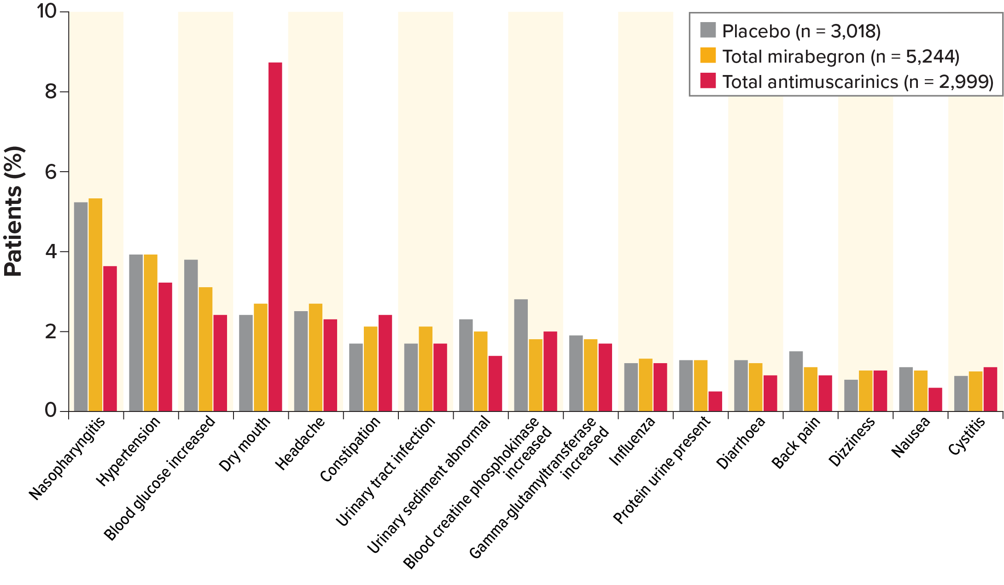
Safety and tolerability of mirabegron
In pooled analysis, mirabegron has been shown to have numerically fewer drug-related adverse events compared with antimuscarinics (17.0% vs. 21.4%)¹
Dry mouth rates reported with mirabegron are lower than with antimuscarinics
Common TEAEs with ≥ 1% Frequency in any treatment group
Dry mouth was more frequent in the antimuscarinics group (8.7%) compared with mirabegron (2.7%) and placebo (2.4%)
Proportion of TEAEs | Placebo | Mirabegron | Antimuscarinics
Dry mouth | 2.4% | 2.7% | 8.7%
Constipation | 1.7% | 2.1% | 2.4%
Hypertension | 3.9% | 3.9% | 3.2%
Urinary tract infection | 1.7% | 2.1% | 1.7%
Tachycardia | 0.5% | 0.9% | 0.5%
TEAE, treatment-emergent adverse event. 1. Chapple C, et al. Eur Urol.. 2020;77(1):119-128.

Slide 40
Thank you!

